Slide 1
A common neural basis for contrast and motion coherence perception
Dan Birman
Gardner Lab
Frisem 2017-06-26

Slide 4
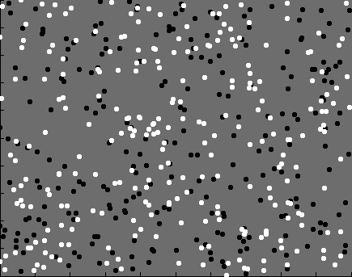

Slide 5
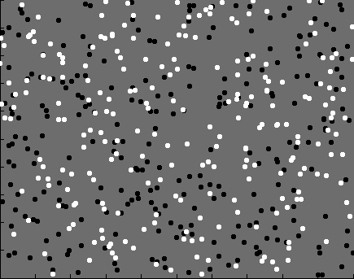
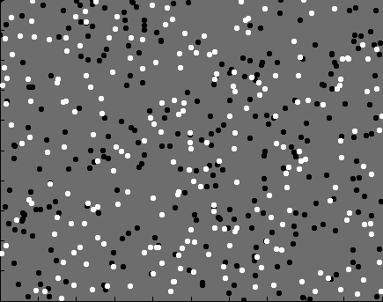
Contrast

Slide 6
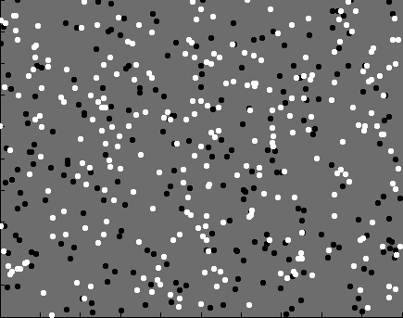
Coherence

Slide 7


Slide 8
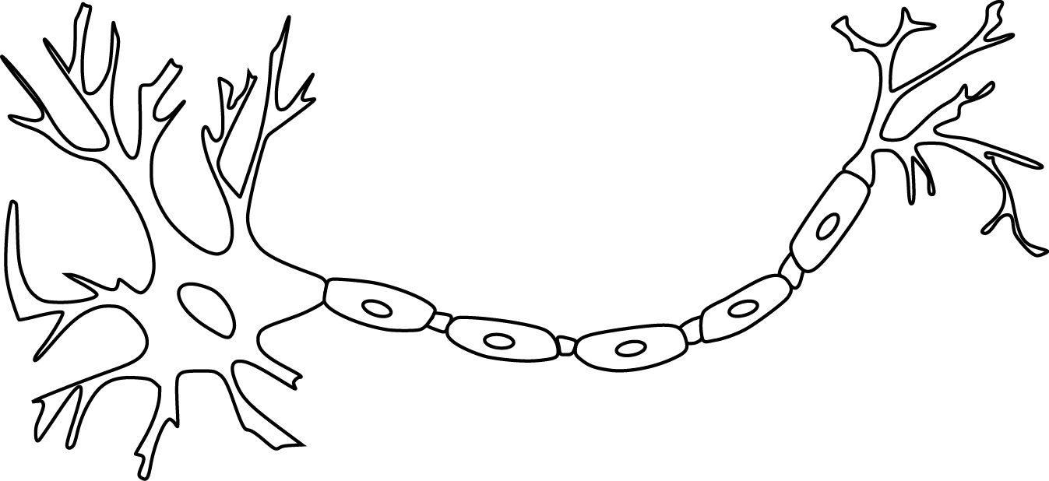

Slide 10
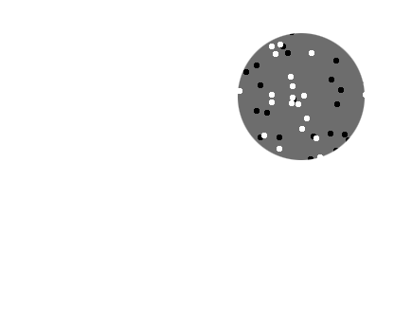
Receptive field

Slide 11
Receptive field

Slide 12
Receptive field

Slide 13
Population
Receptive field

Slide 15
~ 2.5 mm
~ 2.5 mm
~ 2.5 mm

Slide 16
~ 2.5 mm
~ 2.5 mm
~ 2.5 mm
Lots of neurons (10^6-7)

Slide 18
Perception is linked to population representations

Slide 19
Perception is linked to population representations
Model of population representations

Slide 20
Perception is linked to population representations
Model of population representations
Directly linked to behavior

Slide 21
Perception is linked to population representations
Model of population representations
Directly linked to behavior

Slide 22
Perception is linked to population representations
Model of population representations
Directly linked to behavior

Slide 23
Representation of contrast?
Boynton et al. 1999

Slide 24
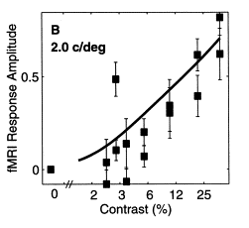
Representation of contrast?
Boynton et al. 1999

Slide 25
Representation of contrast?
Boynton et al. 1999
Representation of coherence?
Rees and Koch 2000

Slide 26
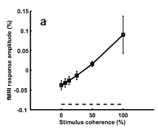
Representation of contrast?
Boynton et al. 1999
Representation of coherence?
Rees and Koch 2000

Slide 27
Representation of contrast?
Boynton et al. 1999
Representation of coherence?
Rees and Koch 2000

Slide 28
Goal: A model of how voxels represent (encode) contrast and motion coherence

Slide 29
Goal: A model of how voxels represent (encode) contrast and motion coherence
Shape: From cortical measurements of BOLD fMRI
Prediction and comparison to a behavioral measure of visibility

Slide 30
Goal: A model of how voxels represent (encode) contrast and motion coherence
Shape: From cortical measurements of BOLD fMRI
Noise: From a behavioral measure of visibility

Slide 31
Goal: A model of how voxels represent (encode) contrast and motion coherence
Shape: From cortical measurements of BOLD fMRI
Noise: From a behavioral measure of visibility

Slide 35
Luminance changes = bad

Slide 40
Cortical measurements

Slide 41
Cortical measurements
11 observers, asynchronous task at fixation
800+ trials (20 per experimental condition)
1 hr retinotopy
4 x 2 hr scanning sessions

Slide 42
Area V1
Area MT

Slide 44
Within-subject analysis: display average across subjects

Slide 45
Within-subject analysis: display average across subjects
Timecourses were averaged within ROIs

Slide 46
Within-subject analysis: display average across subjects
Timecourses were averaged within ROIs
Deconvolution (GLM/finite impulse response) used to obtain separated per-condition measurements

Slide 48
Contrast

Slide 49
Contrast

Slide 50
Contrast

Slide 51
Contrast
Coherence

Slide 52
Contrast
Stimulus length
Coherence

Slide 69
Contrast

Slide 70
Contrast
Coherence

Slide 71
Contrast
Stimulus length
Coherence

Slide 74
Neural response model for cortical measurements

Slide 83
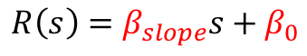
$$R\left(s\right)=β_{slope}s+β_{0}$$
Feature strength

Slide 84
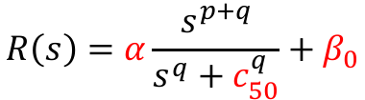
$$R\left(s\right)=β_{slope}s+β_{0}$$
$$R\left(s\right)=α\frac{s^{p+q}}{s^{q}+c_{50}^{q}}+β_{0}$$
Feature strength

Slide 85
$$R\left(s\right)=β_{slope}s+β_{0}$$
$$R\left(s\right)=α\frac{s^{p+q}}{s^{q}+c_{50}^{q}}+β_{0}$$
Feature strength

Slide 87
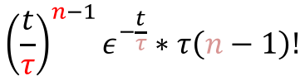
$${\left(\frac{t}{τ}\right)}^{n−1}ε^{−\frac{t}{τ}}∗τ\left(n−1\right)!$$

Slide 88
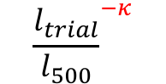
$${\frac{l_{trial}}{l_{500}}}^{−κ}$$

Slide 109
Is the motion coherence response linear?

Slide 110
Is the motion coherence response linear?

Slide 111
Is the motion coherence response linear?

Slide 112
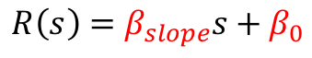
Is the motion coherence response linear?
$$R\left(s\right)=β_{slope}s+β_{0}$$
Feature strength

Slide 113
Is the motion coherence response linear?
$$R\left(s\right)=β_{slope}s+β_{0}$$
Feature strength

Slide 114
Is the motion coherence response linear?
$$R\left(s\right)=β_{slope}s+β_{0}$$
Feature strength

Slide 115
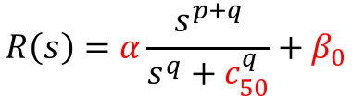
Is the motion coherence response linear?
$$R\left(s\right)=β_{slope}s+β_{0}$$
$$R\left(s\right)=α\frac{s^{p+q}}{s^{q}+c_{50}^{q}}+β_{0}$$
Feature strength

Slide 116
Is the motion coherence response linear?
$$R\left(s\right)=β_{slope}s+β_{0}$$
$$R\left(s\right)=α\frac{s^{p+q}}{s^{q}+c_{50}^{q}}+β_{0}$$
Feature strength

Slide 117
Is the motion coherence response linear?

Slide 118
Is the motion coherence response linear?

Slide 119
Is the motion coherence response linear?

Slide 120
Is the motion coherence response linear?

Slide 121
Is the motion coherence response linear?

Slide 122
Goal: A model of how voxels represent (encode) contrast and motion coherence
Shape: From cortical measurements of BOLD fMRI
Noise: From a behavioral measure of visibility

Slide 123
Goal: A model of how voxels represent (encode) contrast and motion coherence
Shape: From cortical measurements of BOLD fMRI
Noise: From a behavioral measure of visibility

Slide 124
Goal: A model of how voxels represent (encode) contrast and motion coherence
Shape: From cortical measurements of BOLD fMRI
Evidence for similar nonlinear (Naka-Rushton) response functions to contrast and motion coherence
Noise: From a behavioral measure of visibility

Slide 125
Goal: A model of how voxels represent (encode) contrast and motion coherence
Shape: From cortical measurements of BOLD fMRI
Evidence for similar nonlinear (Naka-Rushton) response functions to contrast and motion coherence
Noise: From a behavioral measure of visibility

Slide 128
11 fMRI observers, 21 behavioral observers (1000—2500 trials)

Slide 151
Neural response model for behavioral measurements

Slide 155
$$r_{trial}=β_{con}R\left(Δs_{con}\right)+β_{coh}R\left(Δs_{coh}\right)+β_{bias}$$

Slide 158
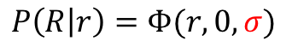
$$P\left(R | r\right)=Φ(r,0,σ)$$

Slide 159
Smaller sigma
(less noise)
$$P\left(R | r\right)=Φ(r,0,σ)$$

Slide 160
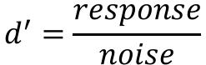
$$d^{′}=\frac{response}{noise}$$
Smaller sigma
(less noise)

Slide 161
Is noise additive or Poisson?

Slide 162
Is noise additive or Poisson?

Slide 163
Is noise additive or Poisson?

Slide 164
Is noise additive or Poisson?

Slide 165
Is noise additive or Poisson?

Slide 166
Is noise additive or Poisson?

Slide 167
Is noise additive or Poisson?

Slide 168
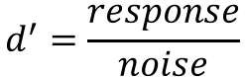
Response amplitude (s.d.)
Stimulus strength (%)
Stimulus strength (%)
$$d^{′}=\frac{response}{noise}$$

Slide 169
Response amplitude (s.d.)
Stimulus strength (%)
Stimulus strength (%)
$$d^{′}=\frac{response}{noise}$$

Slide 170
Response amplitude (s.d.)
Stimulus strength (%)
Stimulus strength (%)
$$d^{′}=\frac{response}{noise}$$

Slide 171
Response amplitude (s.d.)
Stimulus strength (%)
Stimulus strength (%)

Slide 172
Response amplitude (s.d.)
Stimulus strength (%)
Stimulus strength (%)

Slide 173
Additive noise

Slide 174
Additive noise

Slide 175
Poisson noise

Slide 176
Poisson noise

Slide 177
Poisson noise

Slide 178
Is the underlying noise additive or Poisson?

Slide 179
Is the underlying noise additive or Poisson?

Slide 180
Is the underlying noise additive or Poisson?

Slide 181
Is the underlying noise additive or Poisson?

Slide 182
Goal: A model of how voxels represent (encode) contrast and motion coherence
Shape: From cortical measurements of BOLD fMRI
Noise: From a behavioral measure of visibility

Slide 183
Goal: A model of how voxels represent (encode) contrast and motion coherence
Shape: From cortical measurements of BOLD fMRI
Noise: From a behavioral measure of visibility

Slide 184
Goal: A model of how voxels represent (encode) contrast and motion coherence
Shape: From cortical measurements of BOLD fMRI
Evidence for similar nonlinear (Naka-Rushton) response functions to contrast and motion coherence
Noise: From a behavioral measure of visibility

Slide 185
Goal: A model of how voxels represent (encode) contrast and motion coherence
Shape: From cortical measurements of BOLD fMRI
Evidence for similar nonlinear (Naka-Rushton) response functions to contrast and motion coherence
Noise: From a behavioral measure of visibility

Slide 186
Goal: A model of how voxels represent (encode) contrast and motion coherence
Shape: From cortical measurements of BOLD fMRI
Evidence for similar nonlinear (Naka-Rushton) response functions to contrast and motion coherence
Noise: From a behavioral measure of visibility
Judgments of contrast and motion coherence appear to be read out under additive noise

Slide 187
Goal: A joint model of how voxels represent (encode) contrast and motion coherence constrained on fMRI and behavior
Shape: From cortical measurements of BOLD fMRI
Evidence for similar nonlinear (Naka-Rushton) response functions to contrast and motion coherence
Noise: From a behavioral measure of visibility
Judgments of contrast and motion coherence appear to be read out under additive noise

Slide 188
Goal: A joint model of how voxels represent (encode) contrast and motion coherence constrained on fMRI and behavior
Shape: From cortical measurements of BOLD fMRI
Evidence for similar nonlinear (Naka-Rushton) response functions to contrast and motion coherence
Noise: From a behavioral measure of visibility
Judgments of contrast and motion coherence appear to be read out under additive noise

Slide 189
Goal: A joint model of how voxels represent (encode) contrast and motion coherence constrained on fMRI and behavior
Shape: From cortical measurements of BOLD fMRI
Evidence for similar nonlinear (Naka-Rushton) response functions to contrast and motion coherence
Noise: From a behavioral measure of visibility
Judgments of contrast and motion coherence appear to be read out under additive noise

Slide 190
Goal: A joint model of how voxels represent (encode) contrast and motion coherence constrained on fMRI and behavior
Shape: From cortical measurements of BOLD fMRI
Evidence for similar nonlinear (Naka-Rushton) response functions to contrast and motion coherence
Noise: From a behavioral measure of visibility
Judgments of contrast and motion coherence appear to be read out under additive noise

Slide 191

Thanks!
Another person involved in this project:
Justin Gardner

